Slide 1
IONIC + Firebase S-CRUD
Select Records
SLIDES/NOTES
Bit.ly/ionickerul

Slide 2
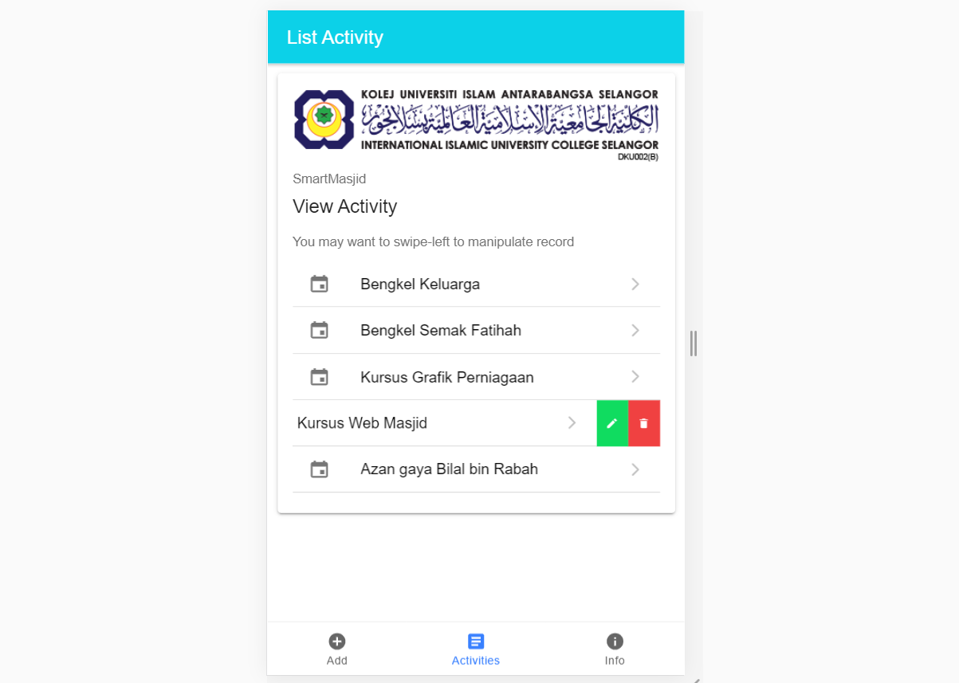
OVERVIEW

Slide 3
IONIC : Create new Ionic project with Tabs
D:\>npm install -g ionic cordova
D:\>ionic start ionmasjid tabs
D:\ionmasjid>npm install firebase @angular/fire
D:\ionmasjid>ionic g service service/firebase

Slide 4
IONIC : environment.ts
Provide the Google Firebase token in environment.ts

Slide 5
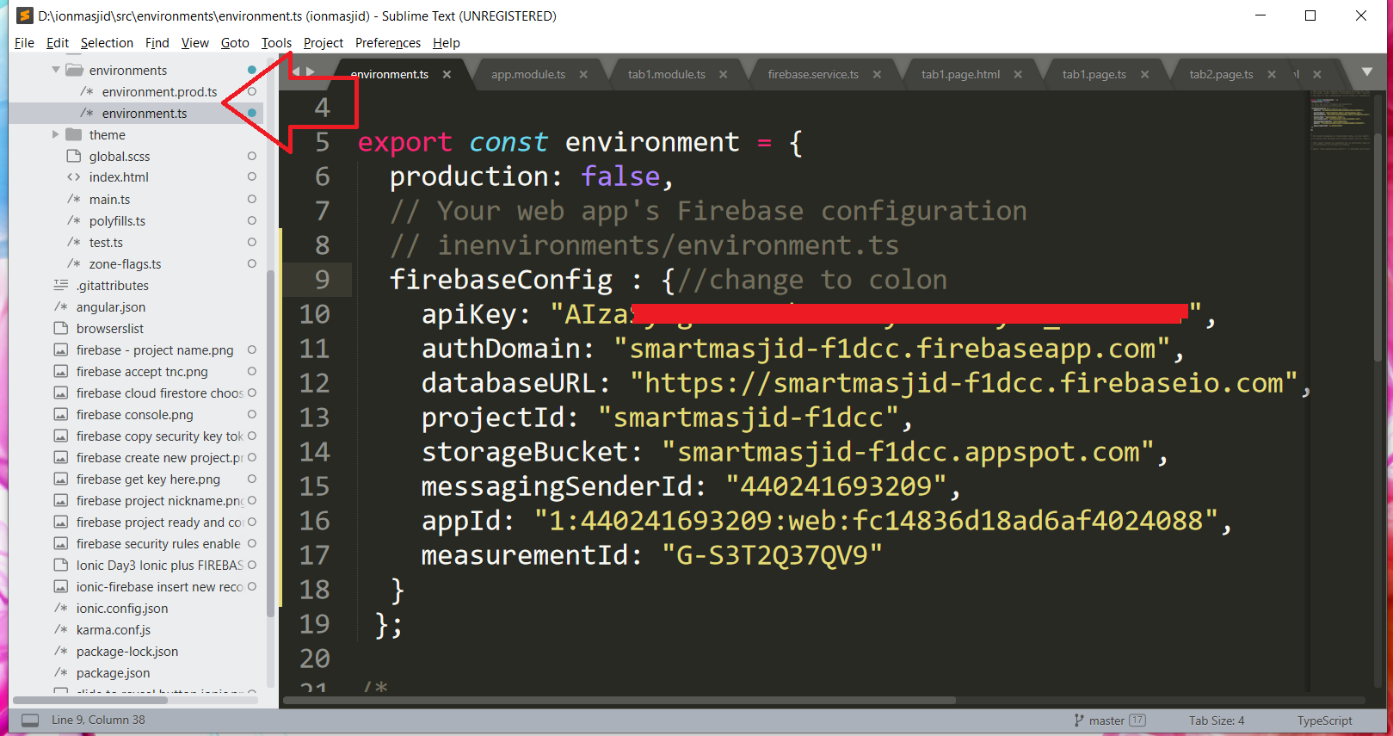
IONIC : environment.ts

Slide 6
IONIC : service/firebase.ts
Select record process to Firebase in service

Slide 7
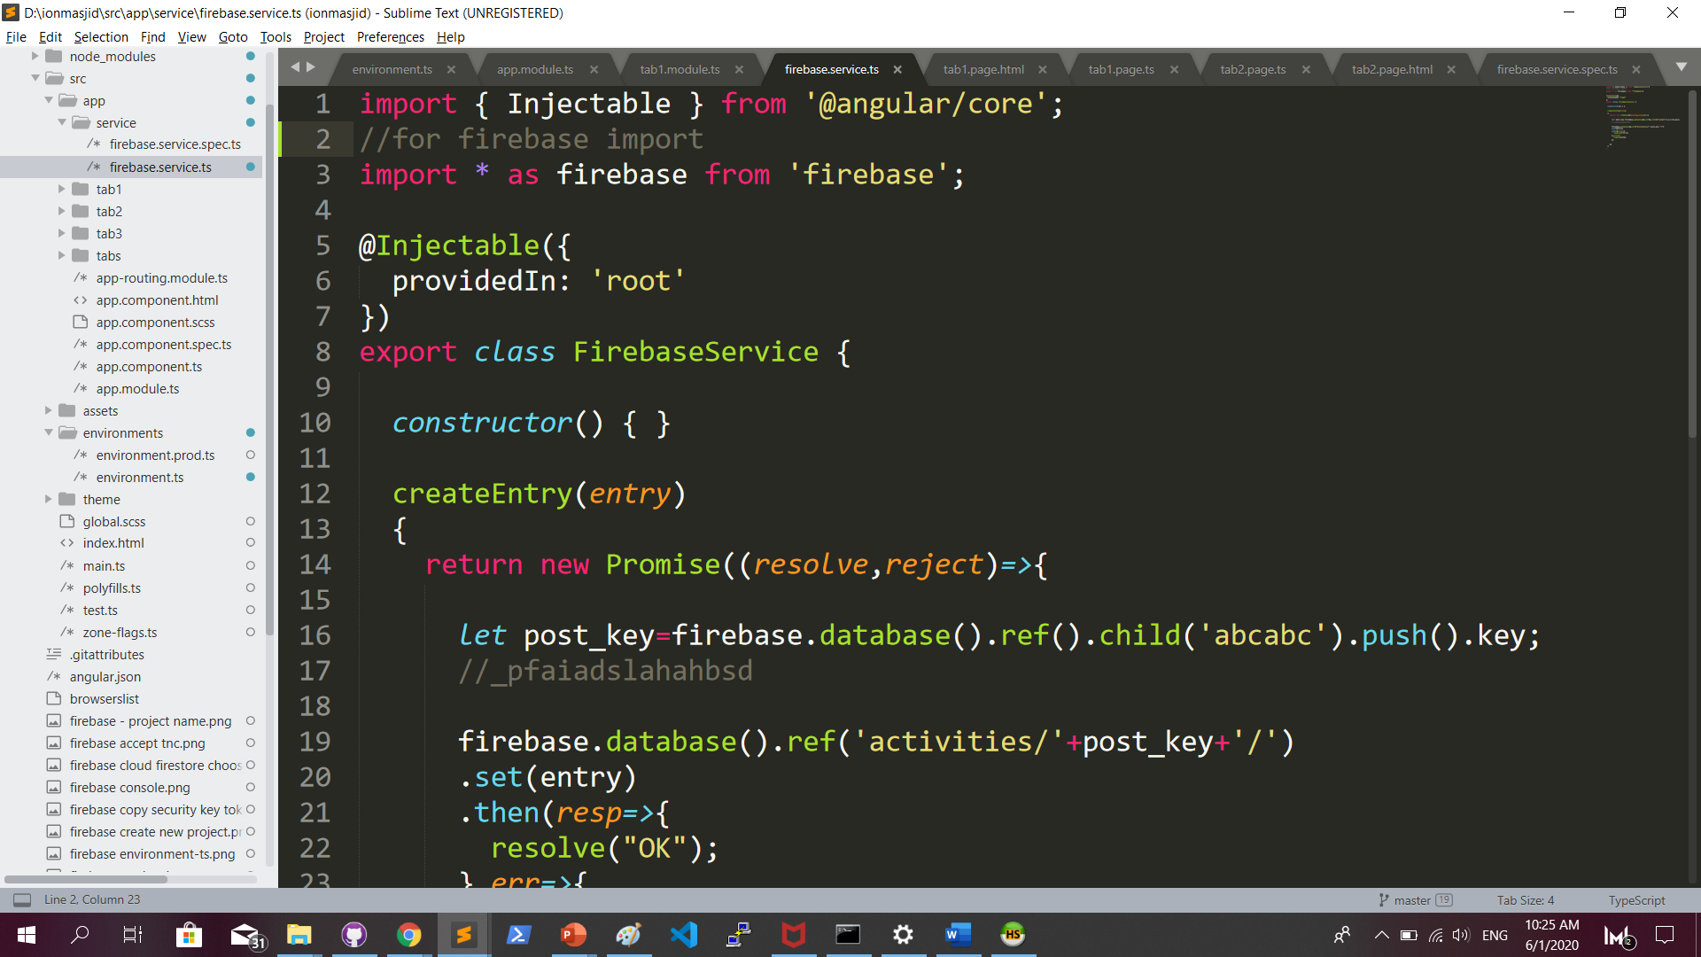
IONIC : service/firebase.ts

Slide 8
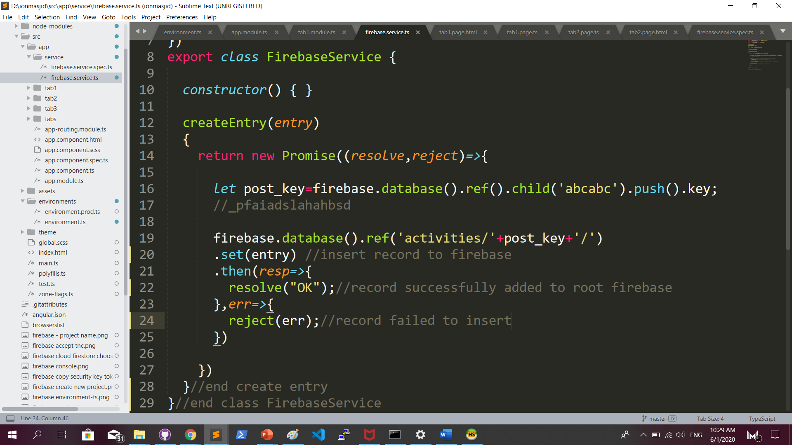
IONIC : service/firebase.ts add function createEntry

Slide 9
IONIC : tab2.page.html

Slide 10
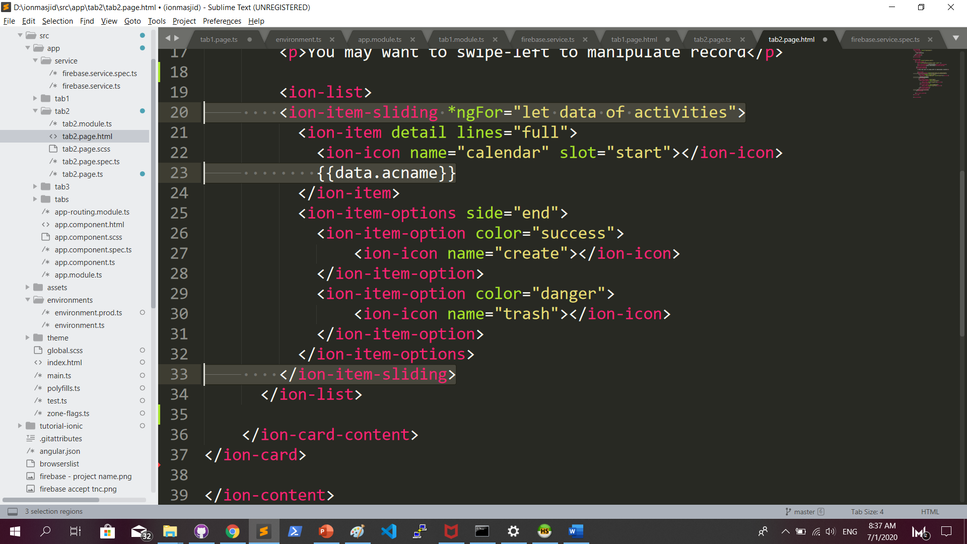
IONIC : tab2.page.html

Slide 11
IONIC : tab2.page.ts
snapshotToArray function to extract record from firebase

Slide 12
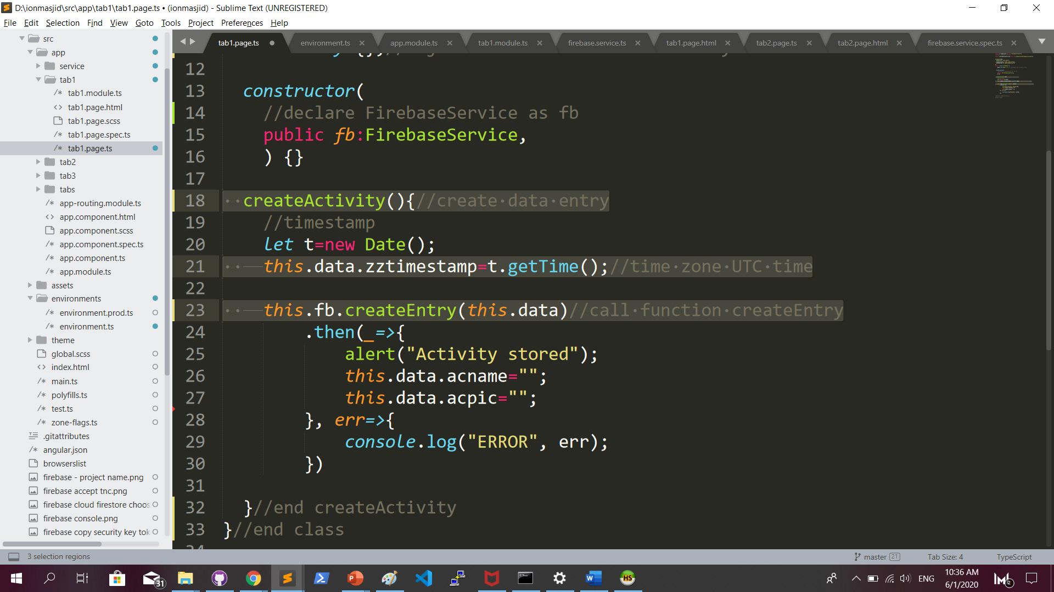
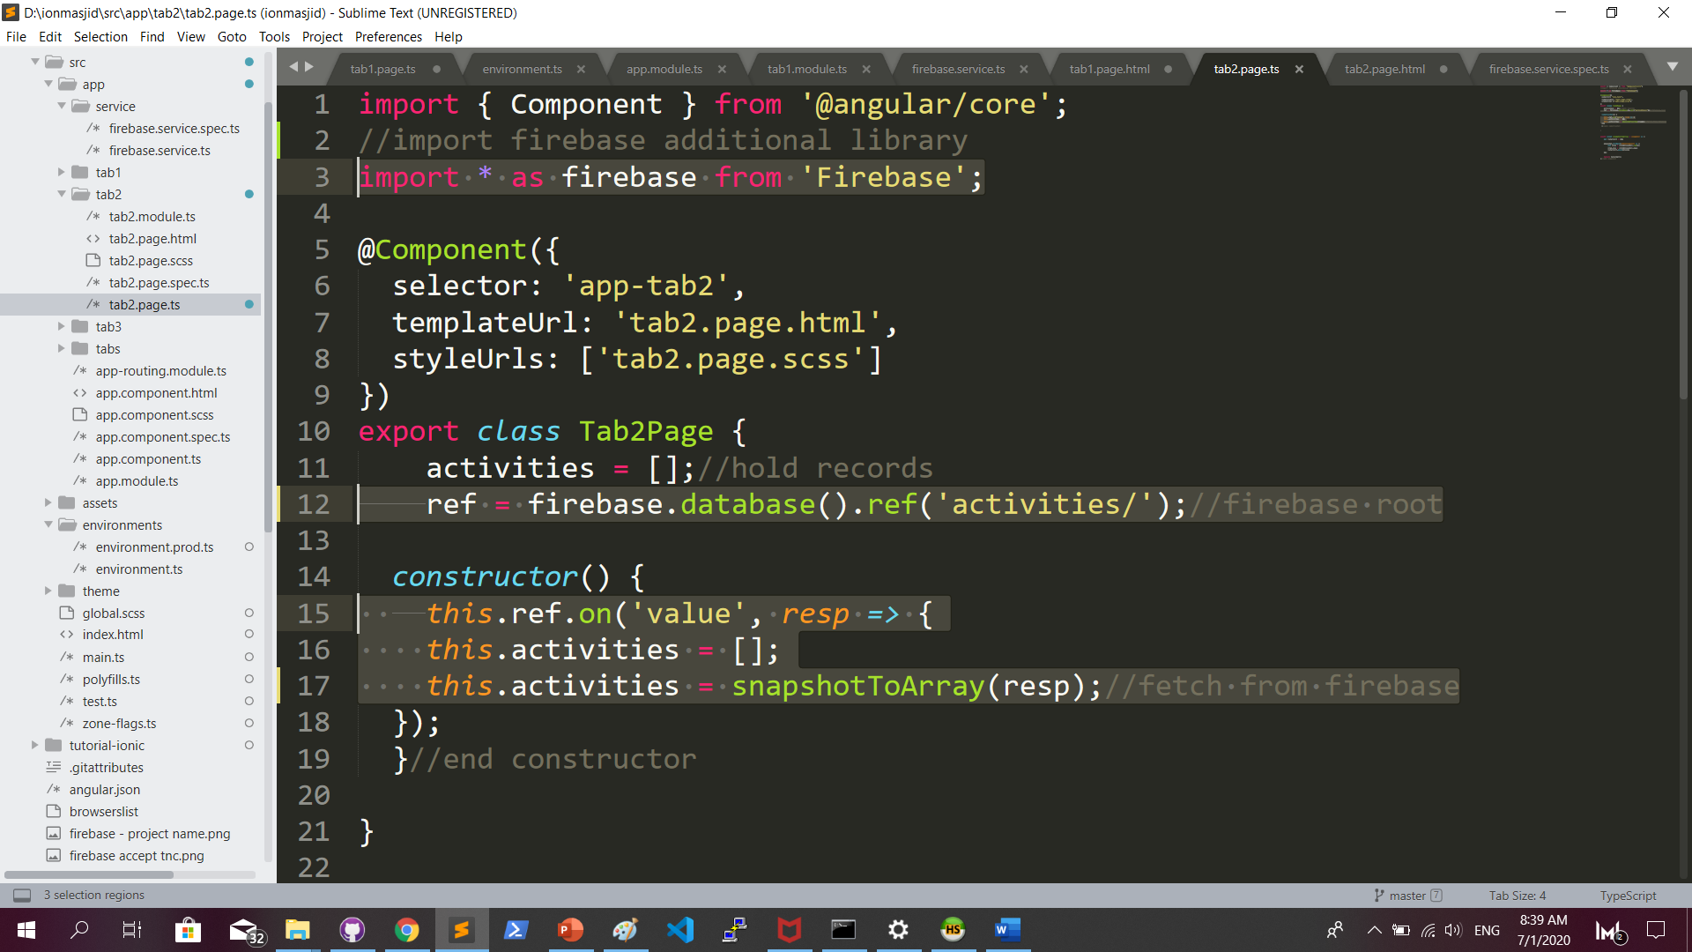
IONIC : tab2.page.ts

Slide 13
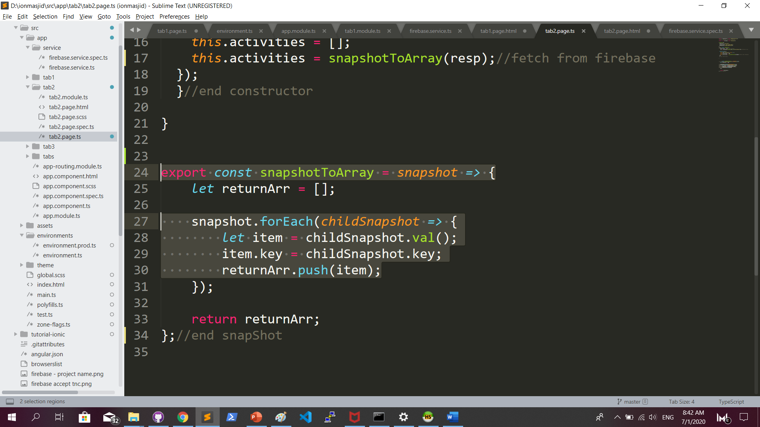
IONIC : tab2.page.ts …continued

Slide 14
IONIC : to test, run ionic serve

Slide 15
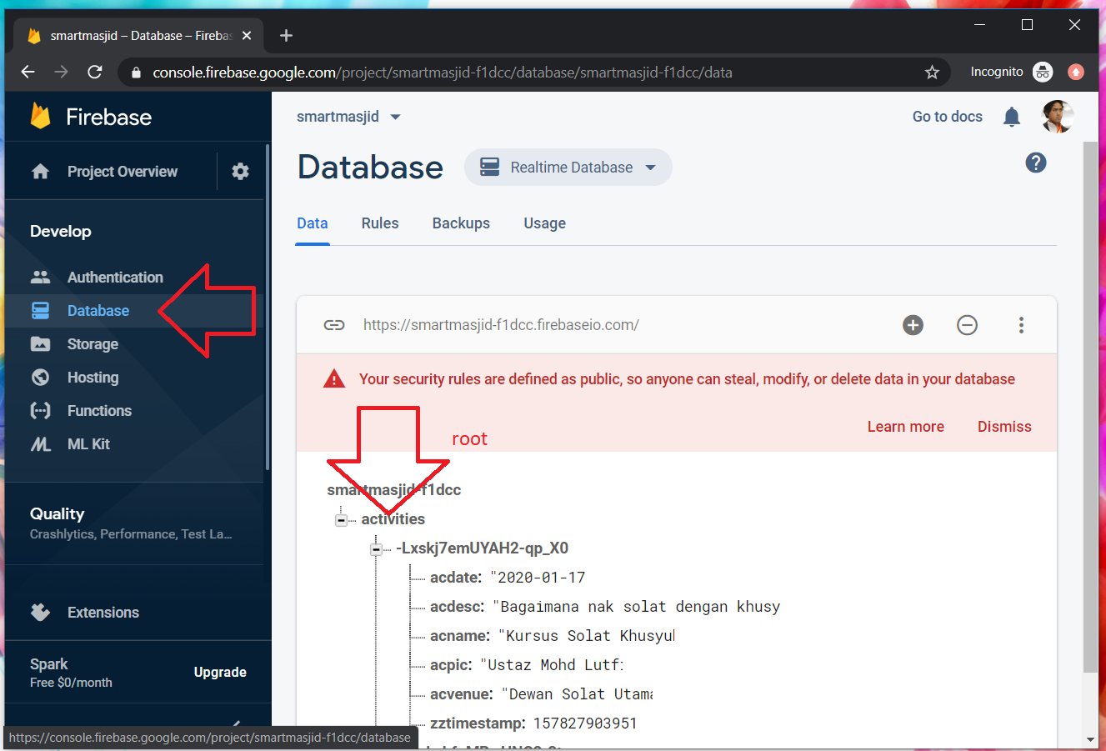
FIREBASE : to view records

Slide 16
S-CRUD – means Search, Create, Update & Delete. Search and Create have been demoed to you.
Now in group, students need to do Search and Update on a new Table named AHLI – with column nama, nomborwasap, email, and akaunInstagram.

Slide 17
UPDATE RECORD

Slide 18
Create a new page named edit
S-CRUD – means Search, Create, Update & Delete. Search and Create have been demoed to you.
Now in group, students need to do Search and Update on a new Table named AHLI – with column nama, nomborwasap, email, and akaunInstagram.

Slide 19
NavigateControl with parameter
tab2
edit
See app-routing.module.ts for page name

Slide 20
Exercise : Link to new page
Let’s generate a new page edit (terminal)
ionic g page edit

Slide 21
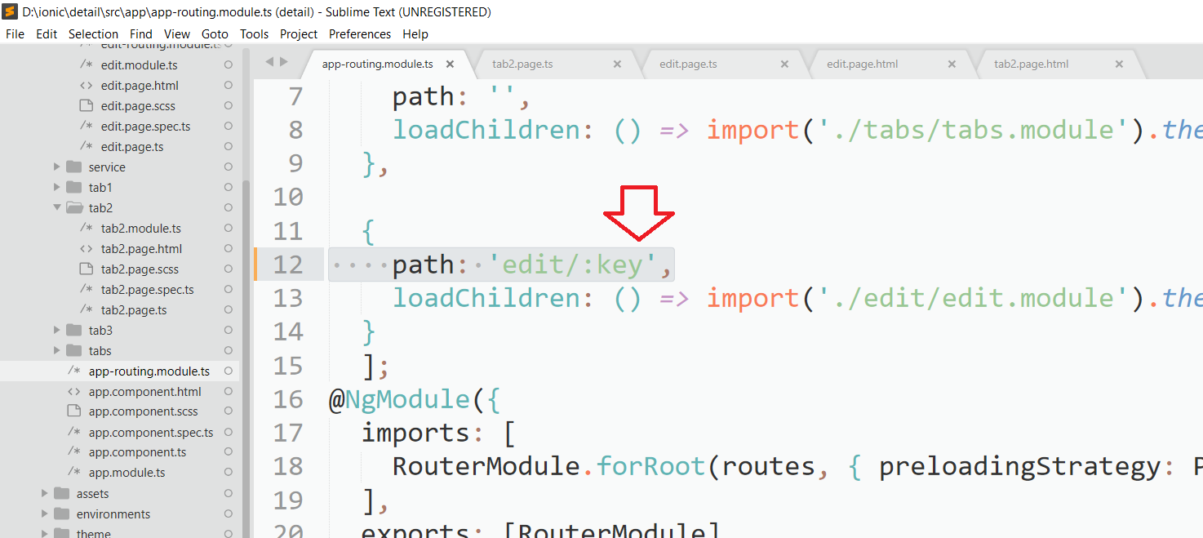
Add param name (key) in app-routing.module.ts

Slide 22
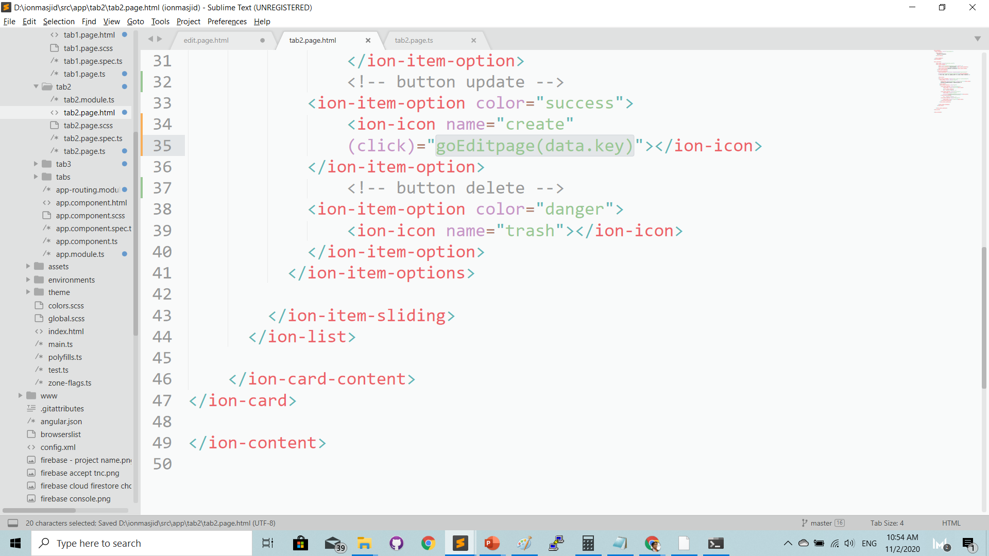
Onclick( ) function on update button - tab2.page.html

Slide 23
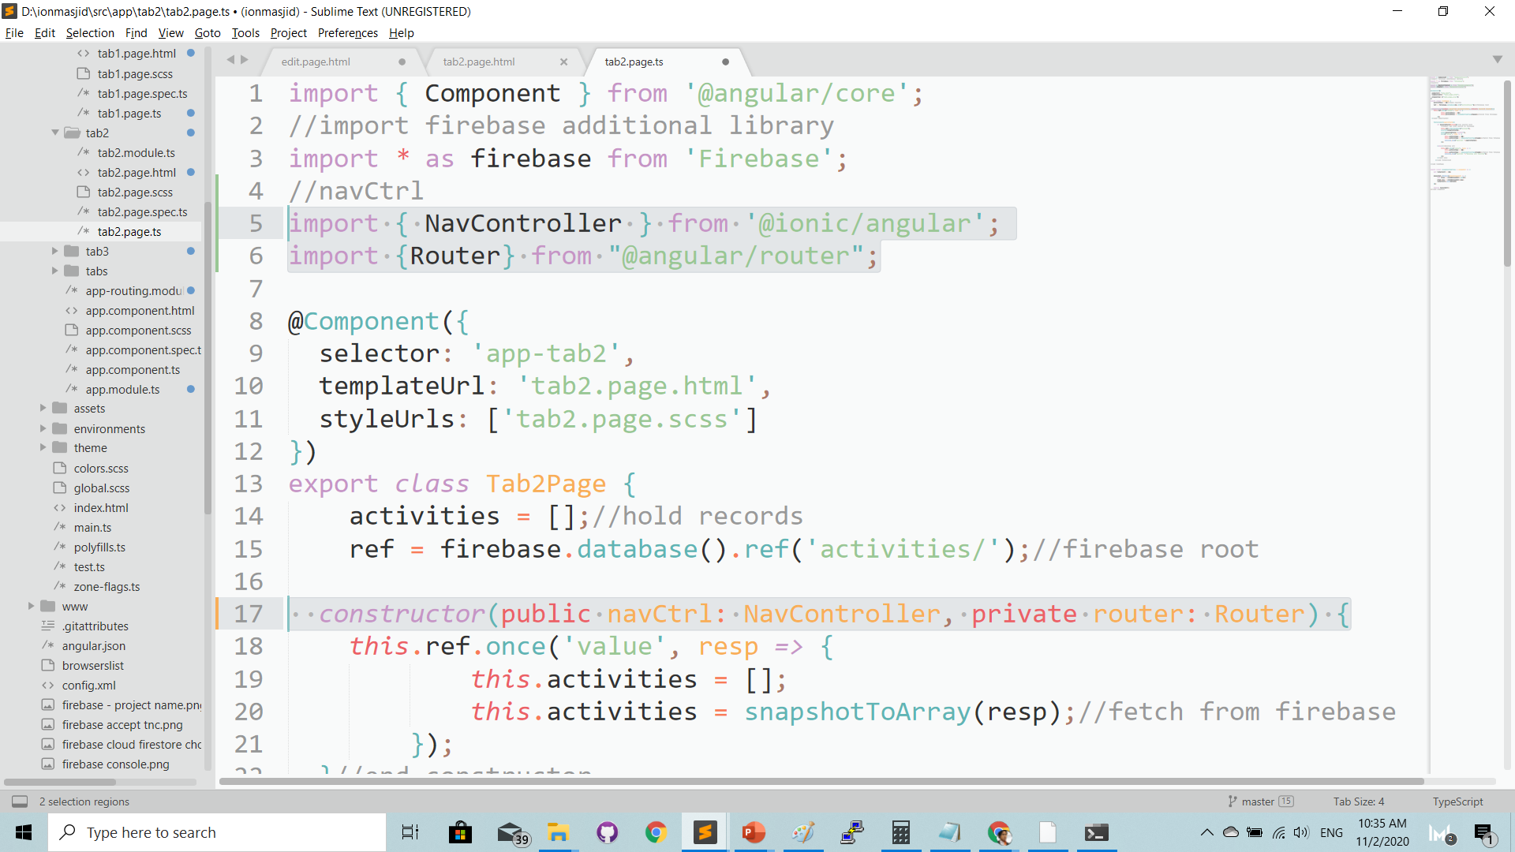
Add NavController & Route in tab2.page.ts

Slide 24
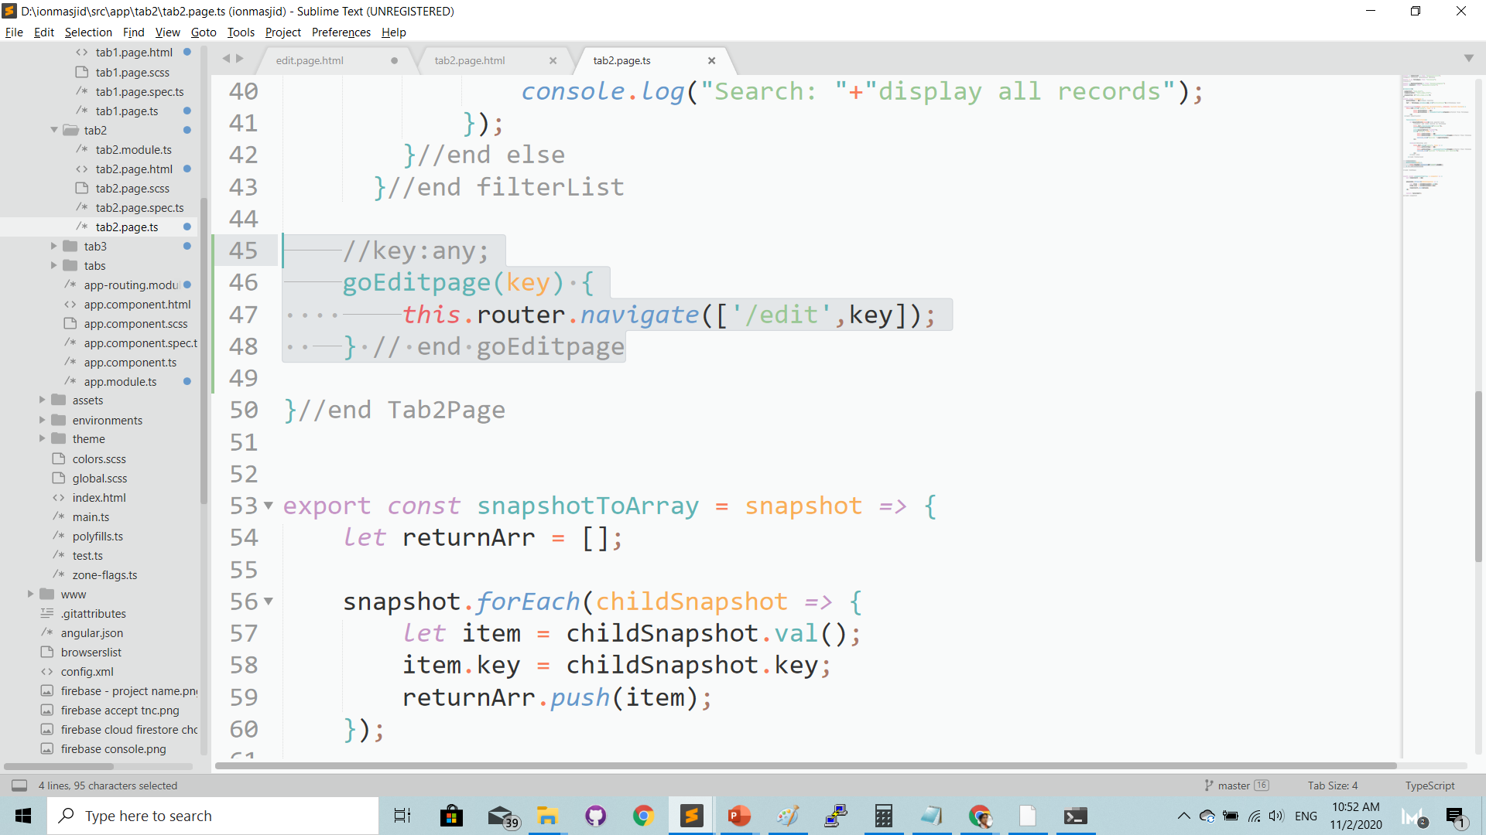
Add goEditpage( ) function to navigate to edit page with parameter

Slide 26
Complete code GITHUB
https://github.com/khirulnizam/ionmasjid

